Slide 1
Machine Learning
Dr. Monali Mavani

Slide 2

Machine Learning
Disclaimer and Acknowledgement
These content of modules & context under topics are planned by the course owner Dr. Sugata, with grateful acknowledgement to many others who made their course materials freely available online
We here by acknowledge all the contributors for their material and inputs.
We have provided source information wherever necessary
Students are requested to refer to the textbook w.r.t detailed content of the presentation deck shared over canvas
We have reduced the slides from canvas and modified the content flow to suit the requirements of the course and for ease of class presentation
Slide Source / Preparation / Review:
From BITS Pilani WILP: Prof.Sugata, Prof.Chetana, Prof.Rajavadhana, Prof.Monali, Prof.Sangeetha, Prof.Swarna, Prof.Pankaj
External: CS109 and CS229 Stanford lecture notes, Dr.Andrew NG and many others who made their course materials freely available online

Slide 3
Session Content
Decision theory
Probabilistic generative models:
Probabilistic discriminative models
Discriminant functions
Logistic regression
Cost function
Gradient descent : learning parameters
Multi-class classification

Slide 4
Decision theory
Probability theory provides a consistent framework for quantifying and manipulating uncertainty
Decision theory combined with probability theory allows us to make optimal decisions in situations involving uncertainty
We have an input vector x together with a corresponding target vector t
goal : predict t given a new value for x
The joint probability distribution p(x, t) provides a complete summary of the uncertainty associated with these variables

Slide 5
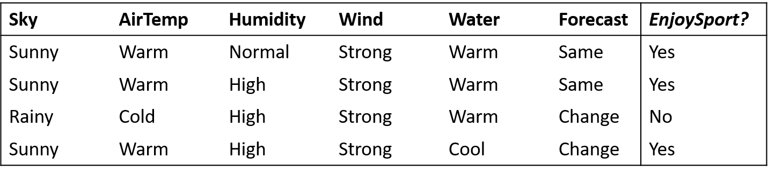
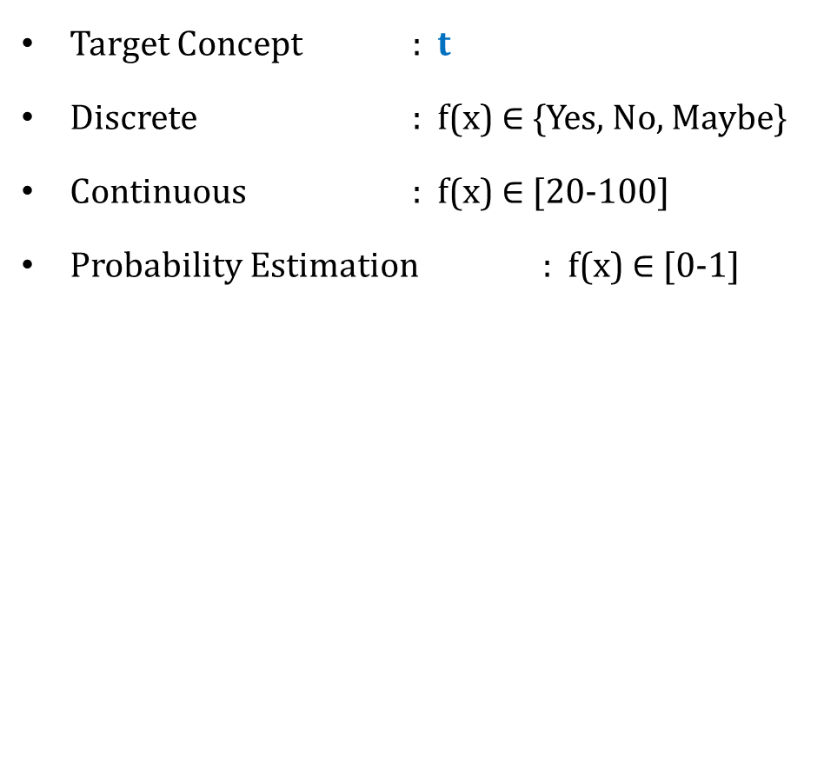
Inductive Learning Hypothesis : Interpretation
Target Concept : t
Discrete : f(x) $∈$ {Yes, No, Maybe}
Continuous : f(x) $∈$ [20-100]
Probability Estimation : f(x) $∈$ [0-1]
Classification
Regression

Slide 6
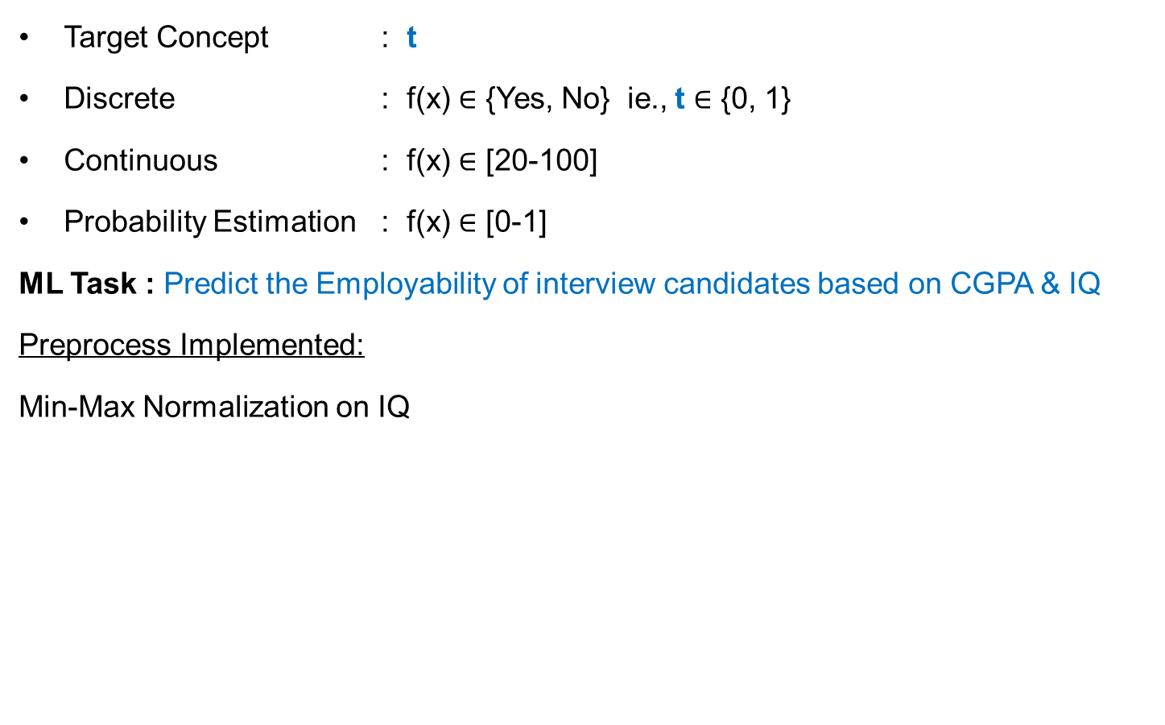
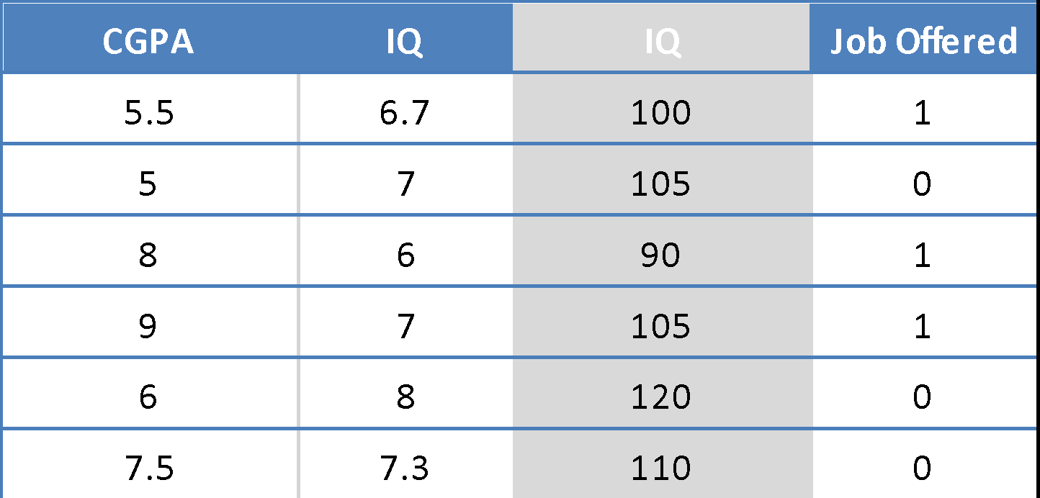
Decision Theory
Binary Classification

Slide 7
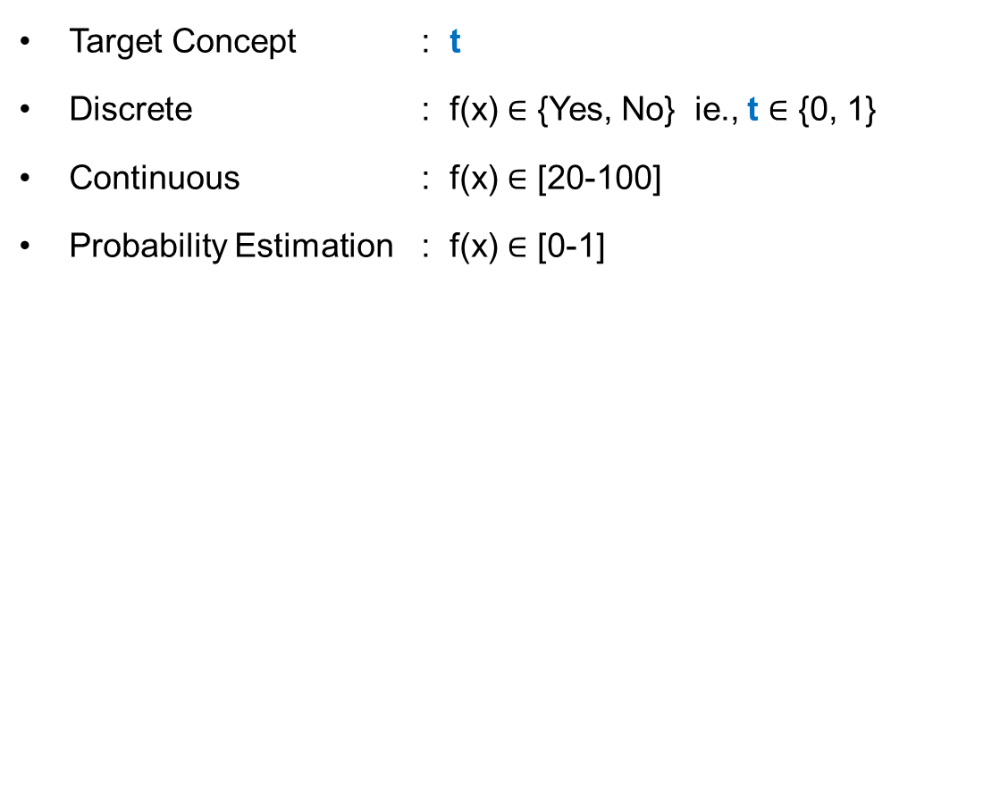
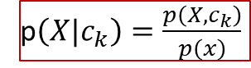
Decision Theory
p$\left(X|c_{k}\right)=\frac{p\left(X,c_{k}\right)}{p\left(x\right)}$
The decision problem: given x, predict t according to a probabilistic model p(x, t)
⇔ {C₁, C₂}
p(x, C_{k}) is the (central!) inference problem
P(Job = 1)
0.8
0.4
0.75
0.95
0.35
0.4
X =< , > = P(C_{k}| X)

Slide 8
Bayes’ rule
We are interested in the probabilities of the two classes, given the input features
Using Bayes’ theorem
p(C_{k} ) = prior probability for class C_{k} and p(C_{k} |x) = its corresponding posterior e.g.
p(C₁) = probability that the person enjoy sport, irrespective of days weather condition
p(C₁|x) = corresponding probability, revised using Bayes in the light of weather information
If our aim is to minimize the chance of assigning x to the wrong class, then intuitively we
would choose the class having the highest posterior probability
This intuition is clearly correct, but why? – decision theory

Slide 9
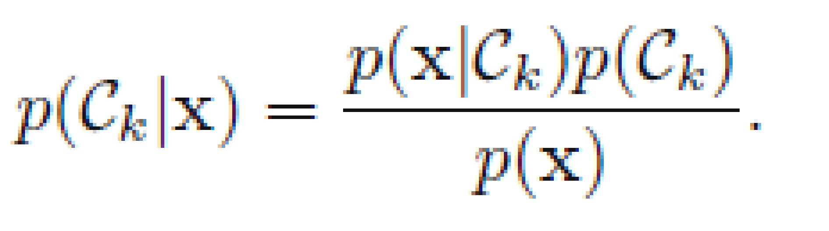

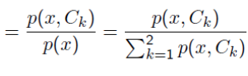
Classification Problem: Stages
CPGA | IQ | Job - Offered
5.5 | 6.7 | 1
5 | 7 | 0
8 | 6 | 1
9 | 7 | 1
6 | 8 | 0
7.5 | 7.3 | 0
Learning
algorithm
Induction/ Inference step
Learn
Model for
p(x,C_{k})
p(x,C_{job=1}) & p(x,C_{job =0})
Training Set
Model
Apply Model to find
optimal t
CPGA | IQ | Job - Offered
3 | 4 | ?
7 | 6 | ?
5.5 | 8 | ?
Deduction/
Decision Step
Test Set

Slide 11
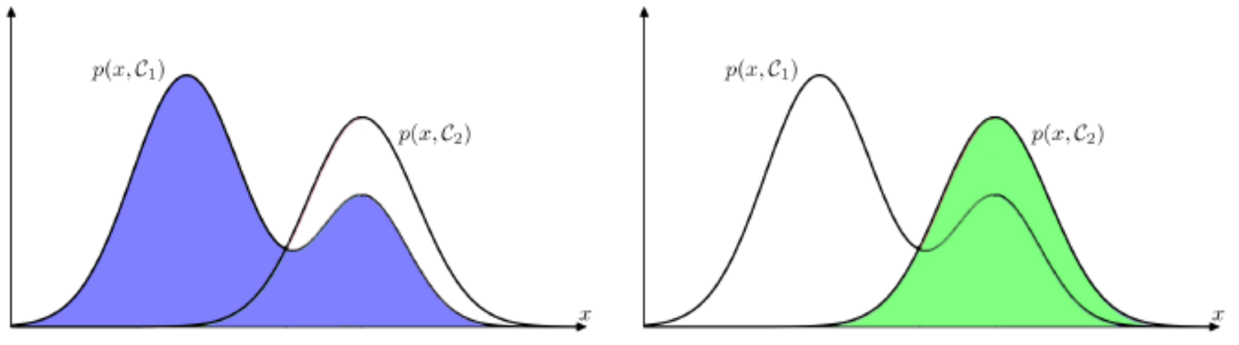
Illustration of the joint probabilities p(x, C_{k})
Training Set
CPGA | IQ | Job - Offered
5.5 | 6.7 | 1
5 | 7 | 0
8 | 6 | 1
9 | 7 | 1
6 | 8 | 0
7.5 | 7.3 | 0
Learning
algorithm
Induction/ Inference step
Learn
Model for
p(x,C_{k})
Probability
Probability
Model
CGPA = 7
CGPA = 7
Prob.Dist for Job = 1
Prob.Dist for Job = 0
CGPA
CGPA

Slide 12
Decision Regions
Sample Rule / Hypothesis:
IF CGPA>7 Job = 1
Else Job = 0
Goal: make as few misclassifications as possible
Need a rule that assigns x to one of the available classes
Such rule divides the input space into regions R_{k} called decision regions, one for each class, such that all points in R_{k} are assigned to class C_{k}
The boundaries between regions are called decision boundaries
For x < x̂ errors represented by sum of the red and green regions (errors are due to points from class C₂ being misclassified as C₁)
For x > x̂ errors represented by the blue region (errors are due to points from class C₁ being misclassified as C₂)

Slide 13
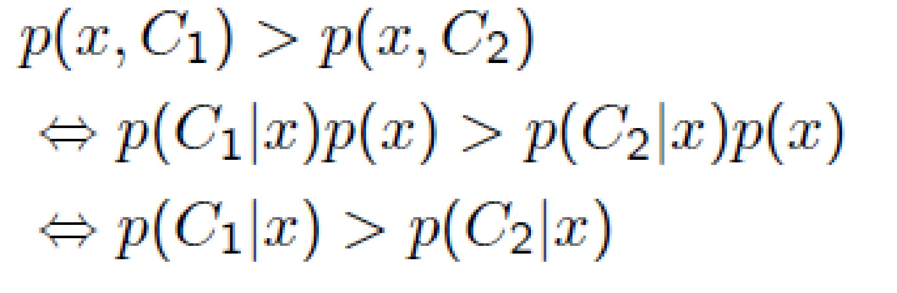
Minimum Misclassification Rate
Minimum error decision rule
For a given x choose class for which integrand is smaller
Since p(x,C_{k})=p(C_{k}|x)p(x),
choose class for which a posteriori probability is highest
Called Bayes Classifier

Slide 14
Decision theory : Interpretation
We have broken the classification problem down into two separate stages
Inference: we use training data to learn a model for p(C_{k} |x)
Decision: we use p(C_{k} |x) to make optimal class assignments
Types of classification models
Rely on a probabilistic model, with 2 flavours:
Generative:
Discriminative
Discriminant functions
choose class for which a posteriori probability is highest

Slide 15
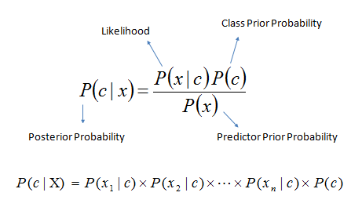
Types of Classification - Generative
Solve the inference problem of determining the class-conditional
densities p(X |C_{k}) for each class C_{k} individually
2. Separately infer the prior class probabilities p(C_{k} )
3. Use Bayes’ theorem to find posterior class probabilities p(C_{k} |x)
Known as generative models, because by sampling from them it is possible to generate synthetic data points in the input space.
Eg., Gaussians, Naïve Bayes, Mixtures of multinomials , Mixtures of Gaussians, Bayesian networks
Estimating the joint probability p(x, Ck) can be computational and data demanding
High dimensionality, and consequently we may need a large training set
CPGA | IQ | Job - Offered
5.5 | 6.7 | 1
5 | 7 | 0
8 | 6 | 1
9 | 7 | 1
6 | 8 | 0
7.5 | 7.3 | 0
… | …. | …..
x₂
x₁

Slide 16
Types of Classification: Discriminative
CPGA | IQ | Job - Offered
5.5 | 6.7 | 1
5 | 7 | 0
8 | 6 | 1
9 | 7 | 1
6 | 8 | 0
7.5 | 7.3 | 0
… | …. | …..
y=1
x₂
_{(IQ)}
Decision Boundary
y=0
x₁ (CGPA)
Infer directly p(C_{k}|x)
No attempt to model underlying probability distributions
we only really need the posterior probabilities
Logistic regression, SVMs , tree based classifiers (e.g. decision tree), traditional neural networks, Nearest neighbor

Slide 17
Example: Spam classification problem
First Strategy: discriminative (e.g., logistic regression)
Use training set to find a decision boundary in the feature space that separates spam and non-spam emails
Given a test point, predict its label based on which side of the boundary it is on.
Second Strategy: generative (e.g., naive bayes)
Look at spam emails and build a model of what they look like.
Similarly, build a model of what non-spam emails look like.
To classify a new email, match it against both the spam and non-spam models to see which is the better fit.
x₂
x₁
x₂
x₁

Slide 18
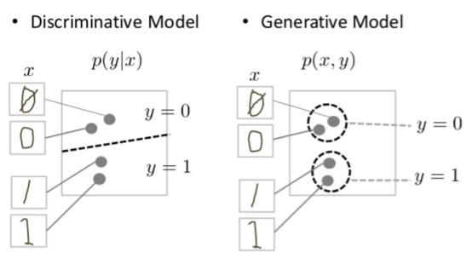

Slide 19
Types of Classification: Discriminant function
There is an alternative, solve inference and decision together
We learn a function that maps inputs into decisions (discriminant function)
Inference and decision are combined into a single learning problem
Probabilities play no role, No access to posterior probabilities p(C_{k}|X)
Find a discriminant function f (x) which maps each input x directly onto a class C_{k}
Linear discriminant function : f (x, w) = w_{o} + w^{T} x
Decision rule: Mathematically→ y = sign(w₀ + w^{T} x)
Decision surfaces are linear and defined by the relation y(x) = 0
linear function of input X
Parameter learning of linear discriminant functions: least squares, Fisher’s linear discriminant, perceptron algorithm

Slide 20
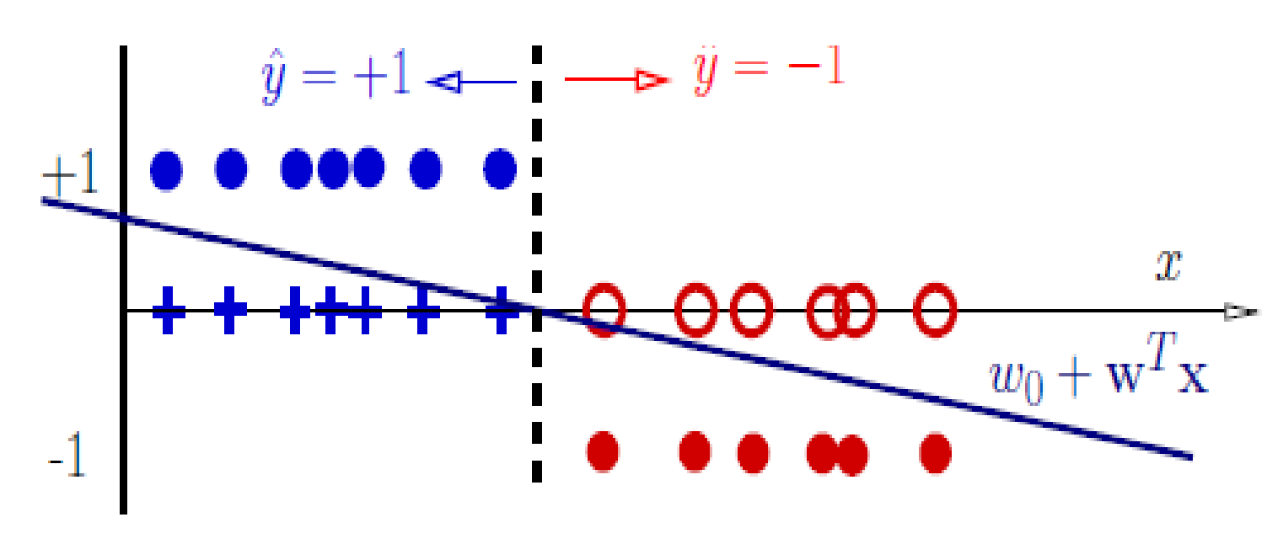
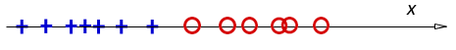
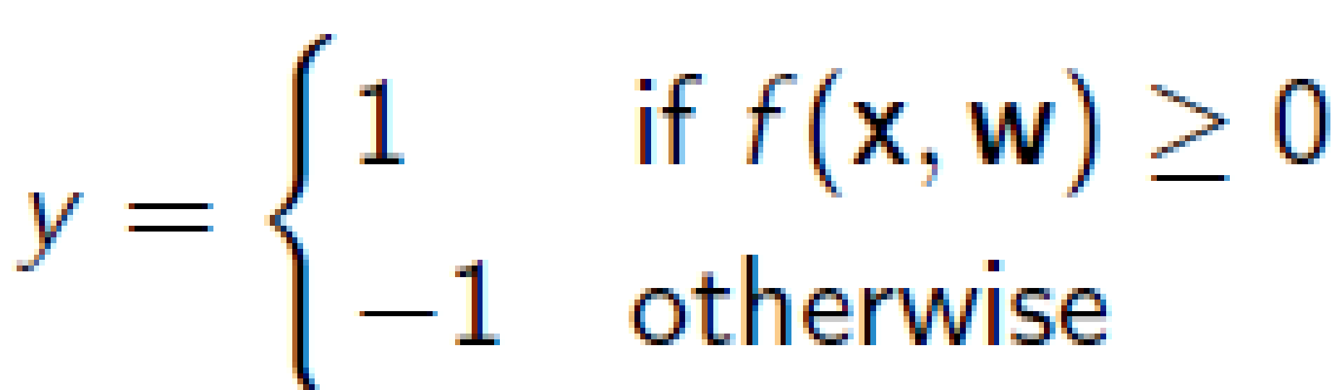
Classification as regression
One dimensional example (input x is 1-dim)
Classifier:
f (x, w) = w_{o} + w^{T} x (linear discriminant function)
Decision rule is
Mathematically
y = sign(w₀ + w^{T} x)
This specifies a linear classifier: it has a linear boundary (hyperplane)
w₀ + w^{T} x = 0

Slide 21
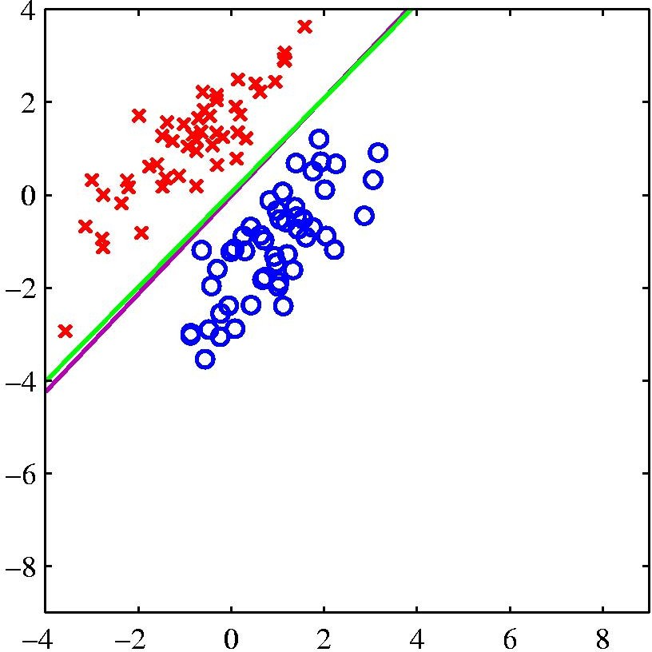
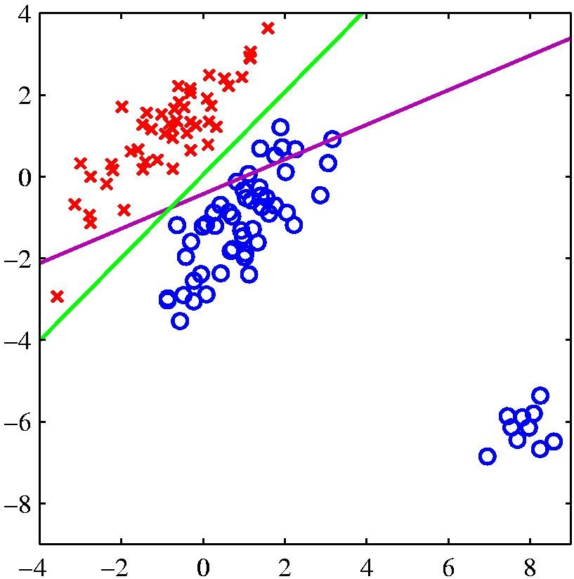
Logistic Regression vs Least Squares Regression
logistic regression
least squares regression
The right-hand plot shows the corresponding results obtained when extra data points are added at the bottom left of the diagram, showing that least squares is highly sensitive to outliers, unlike logistic regression.

Slide 22
Logistic Regression
A probabilistic discriminative classifier, generalized linear model
Sigmoid applied to a linear function of the data
y (x) = σ (w^{T}x + w₀)
where the sigmoid:
The output is a smooth function of
the inputs and the weights
Features can be discrete or continuous
Output of the model: value y ∈ [0, 1]
Allows for gradient-based learning of the parameters

Slide 23
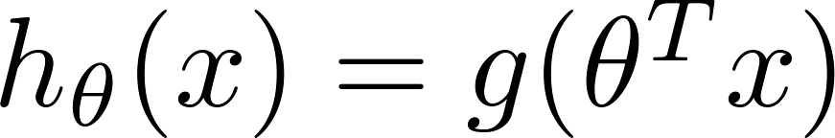
Sigmoid/Logistic Function
Sigmoid/logistic function takes a real value as input and outputs another value between 0 and 1
A useful property: easy to compute differential at any point
That framework is called logistic regression
Logistic: A special mathematical sigmoid function it uses
Regression: Combines a weight vector with observations to create an answer

Slide 24

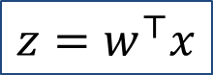
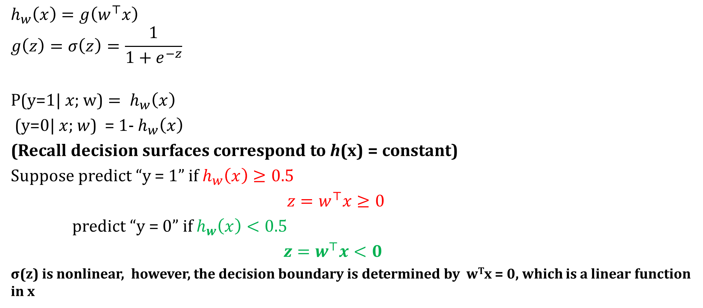
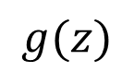
Interpretation of hypothesis output
$$h_{w}\left(x\right)=g\left(w^{⊤}x\right)$$
$$g\left(z\right)=\text{σ}\left(z\right)=\frac{1}{1+e^{−z}}$$
$${\text{P}\text{(}\text{y}\text{=1| }x\text{; }\text{w}\text{)}= h}_{w}\left(x\right)$$
(y=0| $x$; $w$) = 1- $h_{w}\left(x\right)$
(Recall decision surfaces correspond to h(x) = constant)
Suppose predict “y = 1” if $h_{w}\left(x\right)≥0.5$
${z=w}^{⊤}x≥0$
predict “y = 0” if $h_{w}\left(x\right)<0.5$
${z=w}^{⊤}x<0$
σ(z) is nonlinear, however, the decision boundary is determined by w^{T}x = 0, which is a linear function in x
$$z=w^{⊤}x$$
$$g(z)$$

Slide 25
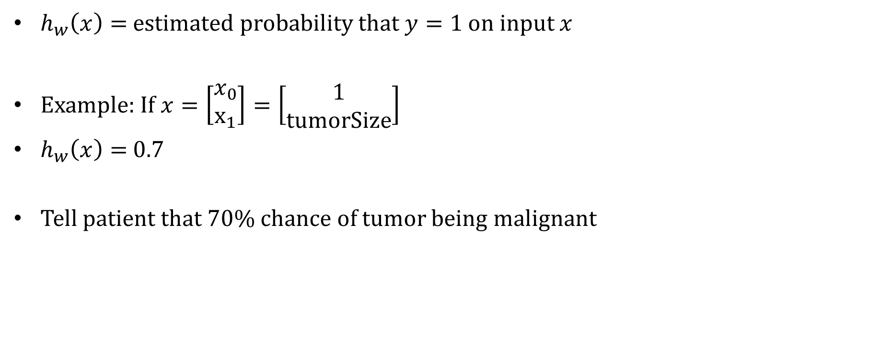
Interpretation of hypothesis output
$h_{w}\left(x\right)=$ estimated probability that $y=1$ on input $x$
Example: If $x=\left[\begin{aligned}x_{0} \\ x_{1}\end{aligned}\right]=\left[\begin{aligned}1 \\ tumorSize\end{aligned}\right]$
$h_{w}\left(x\right)=$ 0.7
Tell patient that 70% chance of tumor being malignant

Slide 26
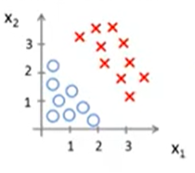
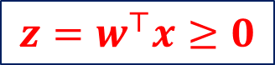
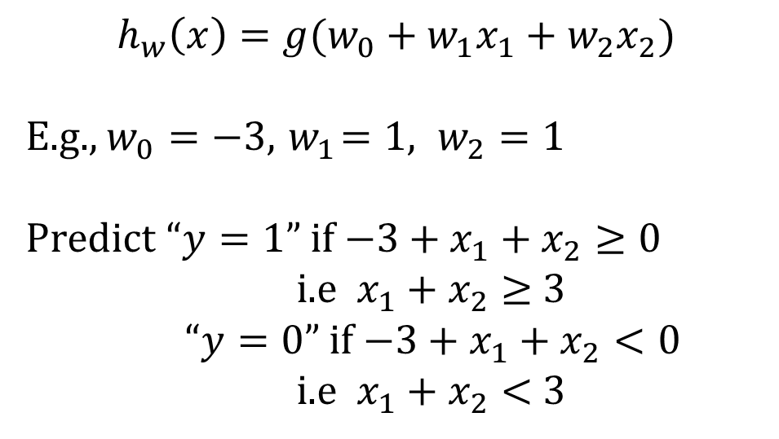
Decision boundary – logistic regression
$${z=w}^{⊤}x≥0$$
$$h_{w}\left(x\right)=g(w_{0}+w_{1}x_{1}+w_{2}x_{2})$$
E.g., $w_{0}=−3, { w}_{1}=1, w_{2}=1$
Predict “$y=1$” if $−3+x_{1}+x_{2}≥0$
i.e $x_{1}+x_{2}≥$ 3
“$y=0$” if $−3+x_{1}+x_{2}<0$
i.e $x_{1}+x_{2}<$ 3

Slide 27
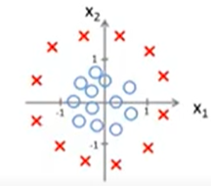
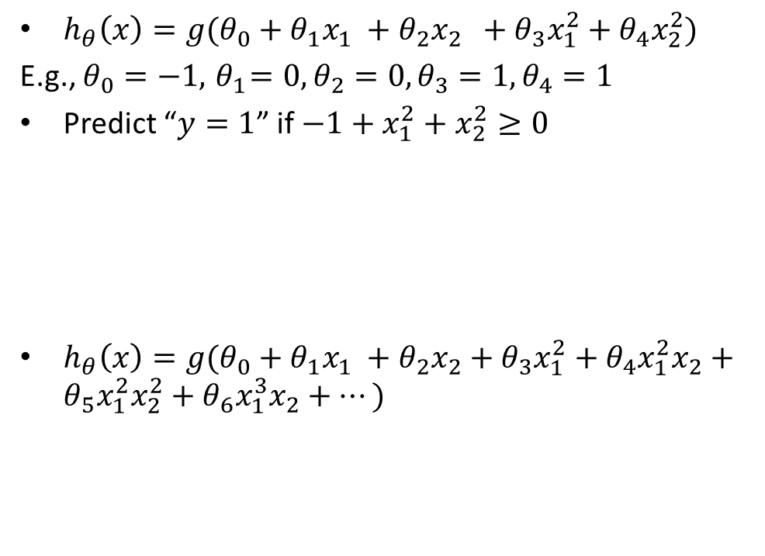
Decision boundary – Fixed basis functions
$h_{θ}\left(x\right)=g(θ_{0}+θ_{1}x_{1} +θ_{2}x_{2}$ $+$ $θ_{3}x_{1}^{2}+θ_{4}x_{2}^{2})$
E.g., $θ_{0}=−1, { θ}_{1}=0, θ_{2}=0,θ_{3}=1, θ_{4}=1$
Predict “$y=1$” if $−1+x_{1}^{2}+x_{2}^{2}≥0$
$h_{θ}\left(x\right)=g(θ_{0}+θ_{1}x_{1} +θ_{2}x_{2}+$ $θ_{3}x_{1}^{2}+θ_{4}x_{1}^{2}x_{2}+θ_{5}x_{1}^{2}x_{2}^{2}+θ_{6}x_{1}^{3}x_{2}+⋯)$

Slide 28
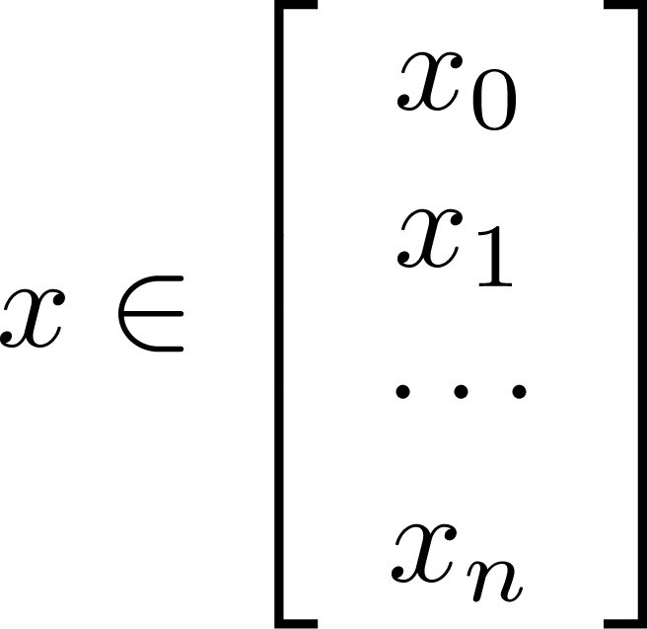
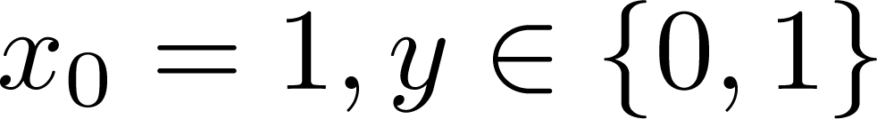
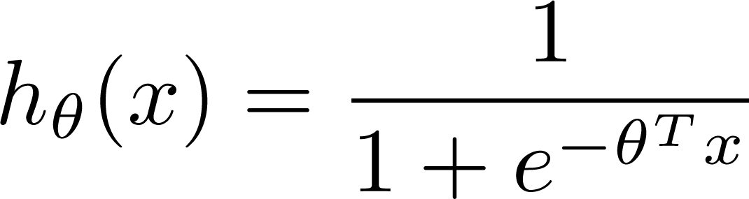
Learning model parameters
Training set:
m examples
How to choose parameters (feature weights) ?

Slide 29
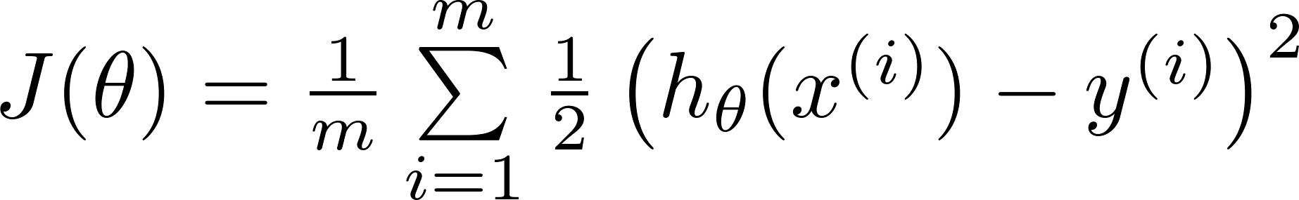


MSE as a Cost Function
Linear regression:
“non-convex”
“convex”

Slide 30
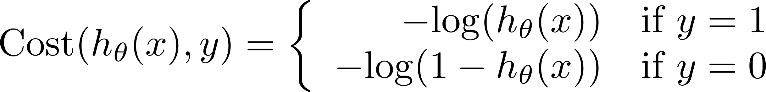
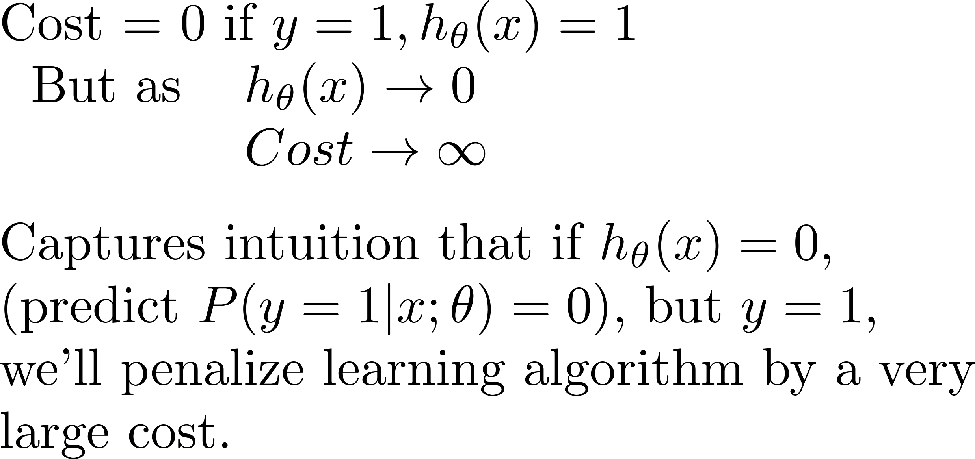
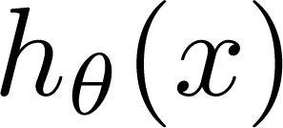
Logistic regression cost function (cross entropy)
If y = 1
ie.,
Actual Value Job Offered = 1
Cost
0
1
Predicted Value
Job Offered = 1
Predicted Value
Job Offered = 0

Slide 31
Logistic regression cost function
If y = 0
ie.,
Actual Value
Job Offered = 0
Cost=0; If y=0 and h_{Ꝋ}(x)=0
Cost
0
Predicted Value
Job Offered = 1
Predicted Value
Job Offered = 0
1

Slide 32
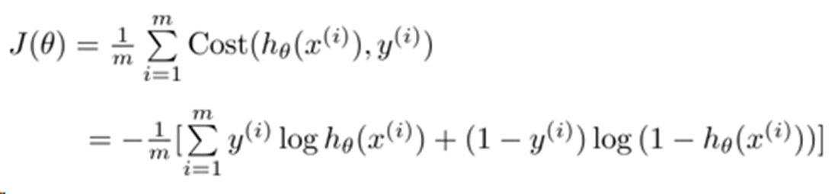

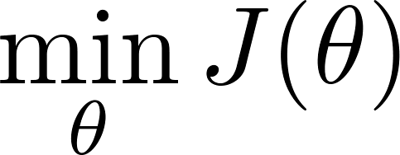
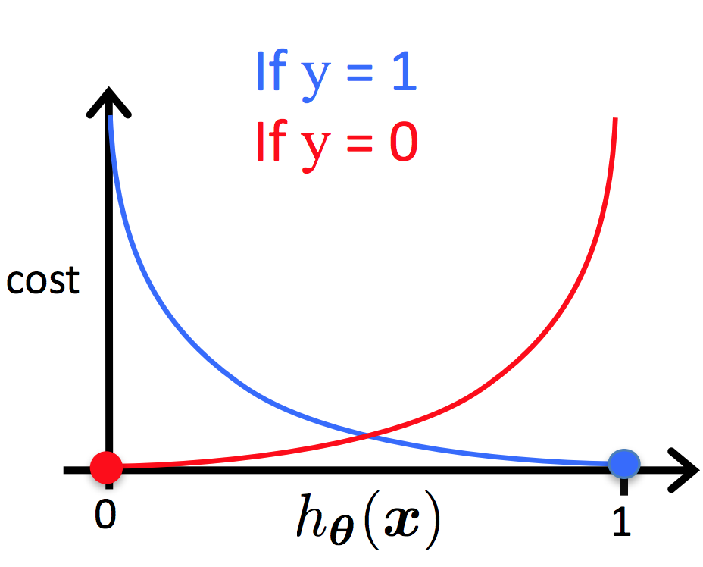

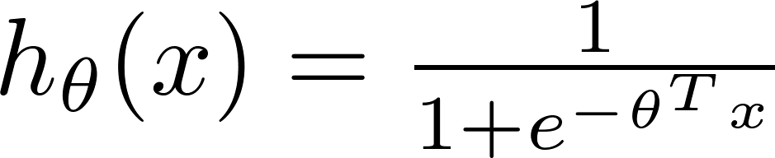
Cost function
To fit parameters : Apply Gradient Descent Algorithm
To make a prediction given new :
Output :

Slide 33
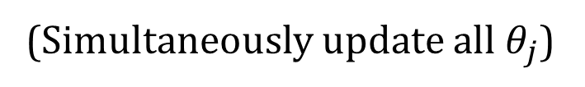
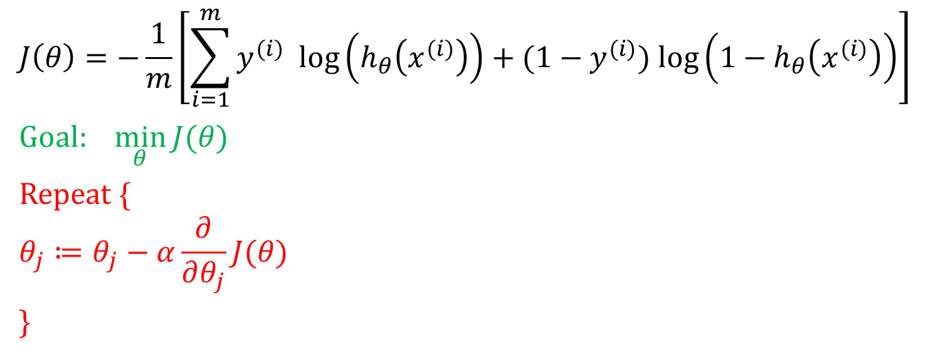
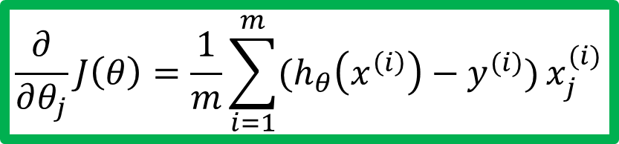
Gradient descent
$$J\left(θ\right)=−\frac{1}{m}\left[\sum_{i=1}^{m}{y^{(i)} log\left(h_{θ}\left(x^{(i)}\right)\right)+(1−y^{(i)}) log\left({1−h}_{θ}\left(x^{(i)}\right)\right)}\right]$$
Goal: $\min_{θ}{J(θ)}$
Repeat {
$$θ_{j}≔θ_{j}−α\frac{∂}{∂θ_{j}}J(θ)$$
}
Good news: Convex function!
Bad news: No analytical solution
(Simultaneously update all $θ_{j}$)
$$\frac{∂}{∂θ_{j}}J\left(θ\right)=\frac{1}{m}\sum_{i=1}^{m}{(h_{θ}\left(x^{\left(i\right)}\right)−y^{(i)})}x_{j}^{(i)}$$

Slide 34
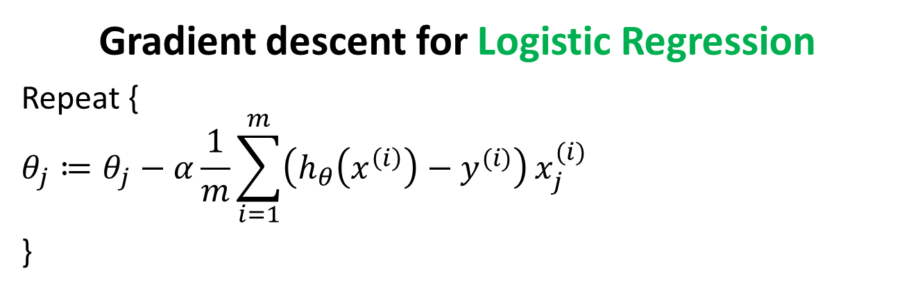
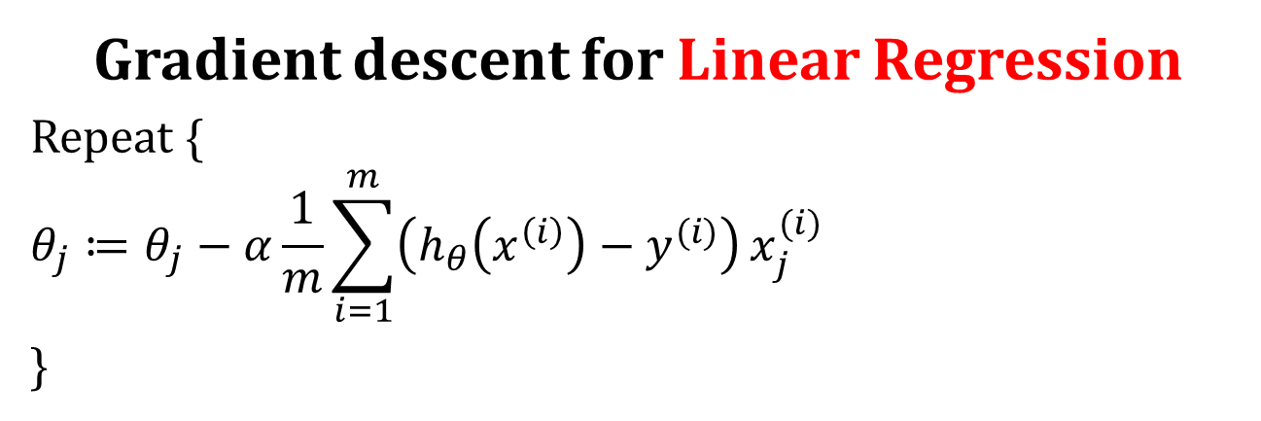
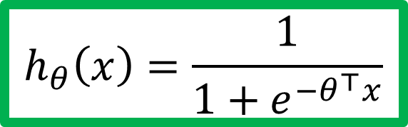

Gradient descent for Linear Regression
Repeat {
$$θ_{j}≔θ_{j}−α\frac{1}{m}\sum_{i=1}^{m}{\left(h_{θ}\left(x^{\left(i\right)}\right)−y^{(i)}\right)}x_{j}^{(i)}$$
}
$$h_{θ}\left(x\right)=θ^{⊤}x$$
Gradient descent for Logistic Regression
Repeat {
$$θ_{j}≔θ_{j}−α\frac{1}{m}\sum_{i=1}^{m}{\left(h_{θ}\left(x^{\left(i\right)}\right)−y^{(i)}\right)}x_{j}^{(i)}$$
}
$$h_{θ}\left(x\right)=\frac{1}{1+e^{−θ^{⊤}x}}$$

Slide 35
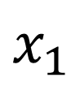
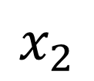
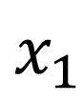
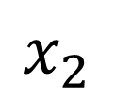
Multi-class classification
Email foldering/tagging: Work, Friends, Family, Hobby
Medical diagrams: Not ill, Cold, Flu
Weather: Sunny, Cloudy, Rain, Snow
Binary classification
Multiclass classification
$$x_{2}$$
$$x_{2}$$
$$x_{1}$$
$$x_{1}$$

Slide 36
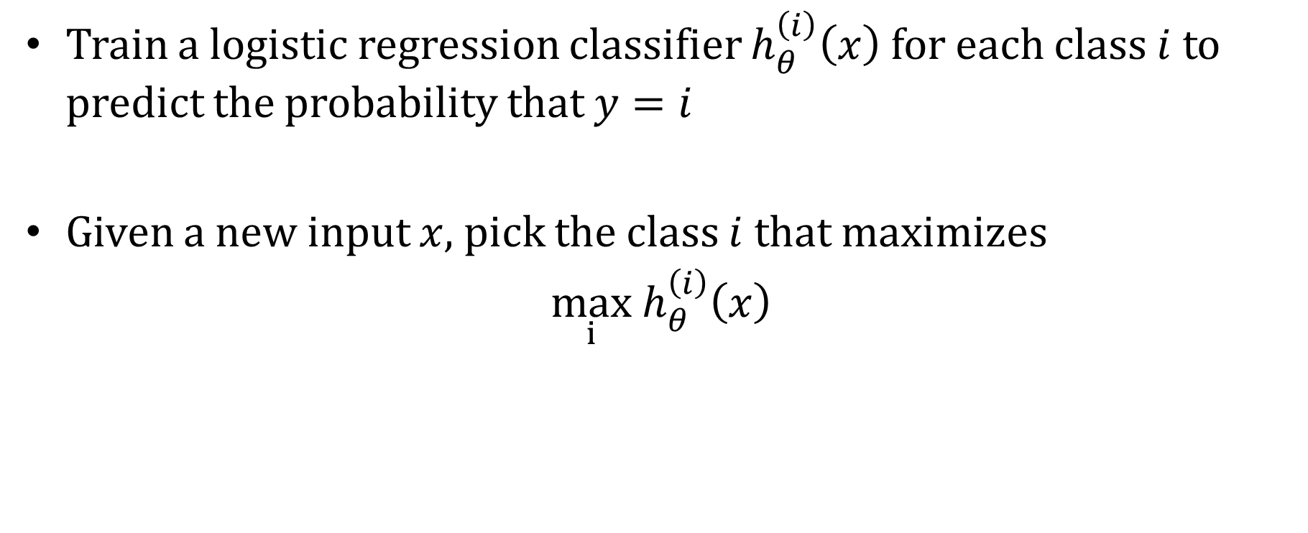
One-vs-all
Train a logistic regression classifier $h_{θ}^{\left(i\right)}\left(x\right)$ for each class $i$ to predict the probability that $y=i$
Given a new input $x$, pick the class $i$that maximizes
$\max_{i}$ $h_{θ}^{\left(i\right)}\left(x\right)$

Slide 37
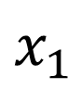











One-vs-all (one-vs-rest)
$$x_{2}$$
$$h_{θ}^{\left(1\right)}\left(x\right)$$
$$x_{1}$$
$$x_{2}$$
$$x_{2}$$
$$h_{θ}^{\left(2\right)}\left(x\right)$$
$$x_{1}$$
$$x_{1}$$
Class 1:
Class 2:
Class 3:
$$h_{θ}^{\left(3\right)}\left(x\right)$$
$$x_{2}$$
$$h_{θ}^{\left(i\right)}\left(x\right)=P\left(y=i | x;θ\right) (i=1, 2, 3)$$
$$x_{1}$$

Slide 38

Logistic regression (Classification)
Model
$h_{θ}\left(x\right)=P\left(Y=1 | X_{1},X_{2}, ⋯, X_{n}\right)=\frac{1}{1+e^{−θ^{⊤}x}}$
Cost function
$$J\left(θ\right)=\frac{1}{m}\sum_{i=1}^{m}{Cost(h_{θ}(x^{\left(i\right)}),y^{(i)}))}$$
$$Cost(h_{θ}\left(x\right),y)=\left\{\begin{aligned}−log\left(h_{θ}\left(x\right)\right) if y=1 \\ −log\left({1−h}_{θ}\left(x\right)\right) if y=0\end{aligned}\right.$$
Learning
Gradient descent: Repeat {$θ_{j} ≔θ_{j}−α\frac{1}{m}\sum_{i=1}^{m}{\left(h_{θ}\left(x^{\left(i\right)}\right)−y^{\left(i\right)}\right)}x_{j}^{\left(i\right)}$}
Inference$\hat{Y}=h_{θ}\left(x^{test}\right)=\frac{1}{1+e^{−θ^{⊤}x^{test}}}$

Slide 39
Example: Sentiment Analysis
Sentiment Features

Slide 40
Classifying sentiment using logistic regression

Slide 41









Logistic Regression – Fit a Model
Hyper parameters:
Learning Rate = 0.3
Initial Weights = (0.5, 0.5,0.5)
Regularization Constant = 0
$θ$^{T}X = 0.5 +0.5 CGPA + 0.5 IQ
$$h_{θ}\left(x\right)=\frac{1}{1+e^{−θ^{⊤}x}}$$
$$θ_{0}≔θ_{0}−0.3\frac{1}{6}\sum_{i=1}^{6}{\left(h_{θ}\left(x^{\left(i\right)}\right)−y^{\left(i\right)}\right)}(1)$$
$$h_{θ}\left(x\right)=\frac{1}{1+e^{−(0.5 +0.5 CGPA + 0.5 IQ )}}$$
$$θ_{CGPA}≔θ_{CGPA}−0.3\frac{1}{6}\sum_{i=1}^{6}{\left(h_{θ}\left(x^{\left(i\right)}\right)−y^{(i)}\right)}x_{CGPA}^{(i)}$$
Approx. : New weights
$θ_{0}$ = 0.4
$θ_{1=CGPA}=$-0.4
$$θ_{2=IQ }=−0.6$$
$$θ_{IQ}≔θ_{IQ}−0.3\frac{1}{6}\sum_{i=1}^{6}{\left(h_{θ}\left(x^{\left(i\right)}\right)−y^{(i)}\right)}x_{IQ}^{(i)}$$

Slide 42
Logistic Regression – Inference & Interpretation
Assume : 0.4+0.3CGPA-0.45IQ
Predict the Job offered for a candidate : (5, 6)
h(x) = 0.31
Y-Predicted = 0 / No

Slide 43



Logistic regression - overfitting
Age
Age
Age
Tumor Size
Tumor Size
Tumor Size
$$h_{θ}\left(x\right)={g(θ}_{0}+θ_{1}x+θ_{2}x_{2})$$
$$h_{θ}\left(x\right)={g(θ}_{0}+θ_{1}x+θ_{2}x_{2}+$$
$$θ_{3}x_{1}^{2}+θ_{4}x_{2}^{2}+θ_{5}x_{1}x_{2})$$
$$h_{θ}\left(x\right)={g(θ}_{0}+θ_{1}x+θ_{2}x_{2}+$$
$$θ_{3}x_{1}^{2}+θ_{4}x_{2}^{2}+θ_{5}x_{1}x_{2}+$$
$$θ_{6}x_{1}^{3}x_{2}+θ_{7}x_{1}x_{2}^{3}+⋯)$$
Underfitting
Overfitting

Slide 44

Regularized logistic regression
Cost function:
$$h_{θ}\left(x\right)={g(θ}_{0}+θ_{1}x+θ_{2}x_{2}+$$
$$θ_{3}x_{1}^{2}+θ_{4}x_{2}^{2}+θ_{5}x_{1}x_{2}+$$
$$θ_{6}x_{1}^{3}x_{2}+θ_{7}x_{1}x_{2}^{3}+⋯)$$
Age
Tumor Size

Slide 45

Regularized logistic regression
Regularized cost function (m=training examples, n = features)
Gradient descent with regularized cost function
Just like with linear regression, we will want to separately update θ₀​ and the rest of the parameters because we do not want to regularize θ₀​.

Slide 46
References
Tom M. Mitchell Generative and discriminative classifiers: Naïve Bayes and Logistic Regression http://www.cs.cmu.edu/~tom/mlbook/NBayesLogReg.pdf
https://cs229.stanford.edu/lectures-spring2022/main_notes.pdf
Pattern recognition and machine learning, Christopher bishop – CH 1.5
http://papers.nips.cc/paper/2020-on-discriminative-vs-generative-classifiers-a-comparison-of-logistic-regression-and-naive-bayes.pdf

Slide 47
Self Learning

Slide 48


Logistic regression GD derivation

Slide 49

Logistic regression cost function
$Cost(h_{θ}\left(x\right),y)=\left\{\begin{aligned}−log\left(h_{θ}\left(x\right)\right) if y=1 \\ −log\left({1−h}_{θ}\left(x\right)\right) if y=0\end{aligned}\right.$
$Cost\left(h_{θ}\left(x\right),y\right)=−y log\left(h_{θ}\left(x\right)\right)−(1−y)$ $log\left({1−h}_{θ}\left(x\right)\right)$
$If y=1$: $Cost\left(h_{θ}\left(x\right),y\right)=−log\left(h_{θ}\left(x\right)\right)$
$If y=0$: $Cost\left(h_{θ}\left(x\right),y\right)=−log\left({1−h}_{θ}\left(x\right)\right)$

Slide 50

Step –I
Applying Chain rule and writing in terms of partial derivatives

Slide 51

Step –II
Evaluating the partial derivative using the pattern of the derivative of the sigmoid function.

Slide 52

Step –III
Simplifying the terms by multiplication

